Slide 1

COP 6731: Theory and Implementation of Database Systems
Advanced SQL

Slide 2
Review
The relational data model is a data abstraction that
presents the data in a database as a set of tables,
which are also called relations.
A relation is a table consisting of columns and rows.
An attribute is a named column of a relation.
A domain is the set of allowable values for one or more attributes.
A tuple is a row of a relation.
The degree of a relation is the number of attributes.
The cardinality of a relation is the number of tuples.

Slide 3
Review
Relational Keys
Superkey is an attribute, or set of attributes, that uniquely identifies a tuple within a relation.
Candidate Key is a superkey such that no proper subset is a superkey within the key relation.
Primary Key is the candidate key that is selected to identify tuples uniquely within the key relation.
Foreign Key is an attribute, or set of attributes, within one relation that matches the candidate key of some (possibly the same) relation.

Slide 4
Review
Entity Integrity
No attribute of a primary key can be null.
Referential Integrity
If a foreign key exists in a relation, either the foreign key value must match a candidate key value of another relation or the foreign key value must be null.

Slide 5
Review (Create Table)
Create Table Employee (
Ssn char(9) NOT NULL,
Fname varchar(15) NOT NULL,
Lname varchar(15) NOT NULL,
Super_ssn char(9),
Dno int NOT NULL DEFAULT 9,
Primary Key (Ssn),
Foreign Key (Super_ssn) References Employee (Ssn),
Foreign Key (Dno) References Department (Dnumber)
On Delete On Update
SET NULL
SET DEFAULT
CASCADE
SET NULL
SET DEFAULT
CASCADE

Slide 6
Review
SELECT [DISTINCT] <column> [AS new name] [,…]
FROM <tables> [alias] [,…]
<Optional>
WHERE clause
WHERE clause ➔ (TRUE | FALSE)
Describe JOIN condition
Describe SEARCH condition

Slide 7
Join
Join
NATURAL-JOIN
EQUI-JOIN
OUTER-JOIN

Slide 8
Cross Product
Students
Enrolls
sid | name
S01 | Susan
S02 | Luke
S03 | John
S04 | Aliza
S05 | Sarah
sid | cid
S01 | C01
S01 | C02
S02 | C01
sid | name | sid | cid
S01 | Susan | S01 | C01
S01 | Susan | S01 | C02
S01 | Susan | S02 | C01
S02 | Luke | S01 | C01
S02 | Luke | S01 | C02
S02 | Luke | S02 | C01
S03 | John | S01 | C01
S03 | John | S01 | C02
S03 | John | S02 | C01
S04 | Aliza | S01 | C01
S04 | Aliza | S01 | C02
S04 | Aliza | S02 | C01
S05 | Sarah | S01 | C01
S05 | Sarah | S01 | C02
S05 | Sarah | S02 | C01
Students ✕ Enrolls
SELECT *
FROM Students S, Enrolls E;

Slide 9
Equi-Join
Students
Enrolls
sid | name
S01 | Susan
S02 | Luke
S03 | John
S04 | Aliza
S05 | Sarah
sid | cid
S01 | C01
S01 | C02
S02 | C01
sid | name | sid | cid
S01 | Susan | S01 | C01
S01 | Susan | S01 | C02
S01 | Susan | S02 | C01
S02 | Luke | S01 | C01
S02 | Luke | S01 | C02
S02 | Luke | S02 | C01
S03 | John | S01 | C01
S03 | John | S01 | C02
S03 | John | S02 | C01
S04 | Aliza | S01 | C01
S04 | Aliza | S01 | C02
S04 | Aliza | S02 | C01
S05 | Sarah | S01 | C01
S05 | Sarah | S01 | C02
S05 | Sarah | S02 | C01
Students ⋈ Enrolls
SELECT *
FROM Students S, Enrolls E
WHERE S.sid = E.sid;

Slide 10
Equi-Join
Offering
OfferNo | FacSSN
1111 | 111-11-1111
2222 | 222-22-2222
3333 | 111-11-1111
Faculty
FacSSN | FacName
111-11-1111 | JOE
222-22-2222 | SUE
333-33-3333 | SARA
SELECT O.OfferNo, O.FacSSN, F.FacName
FROM Offering O JOIN Faculty F ON O.FacSSN =F.FacSSN;
SELECT O.OfferNo, O.FacSSN, F.FacName
FROM Offering O, Faculty F
WHERE O.FacSSN =F.FacSSN;
OfferNo
FacSSN
FacName
1111
111-11-1111
JOE
2222
222-22-2222
SUE
3333
111-11-1111
JOE

Slide 11
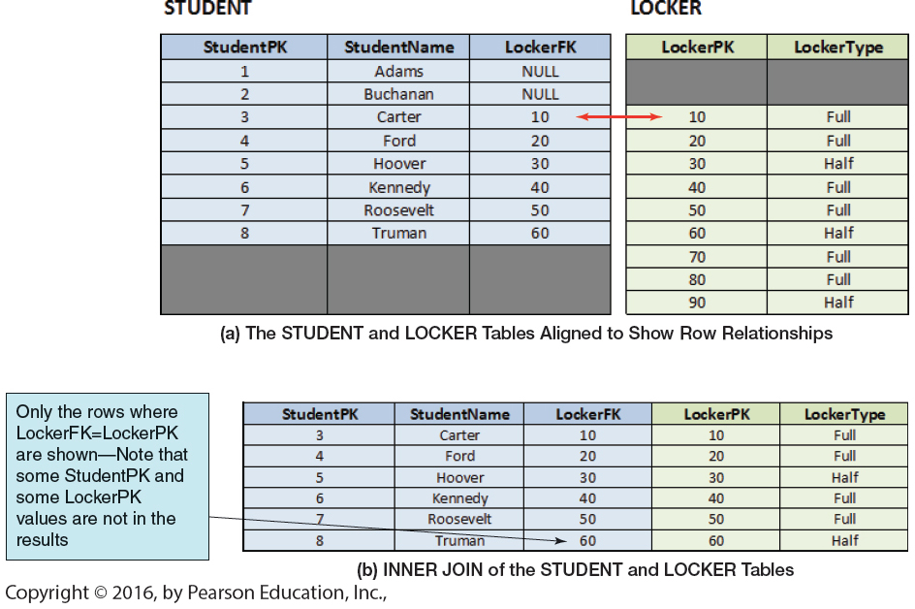
Equi-Join
SELECT *
FROM Student S, Locker L
WHERE S.LockerFK = L.LockerPK;
SELECT *
FROM Student S JOIN Locker L ON S.LockerFK = L.LockerPK;

Slide 12
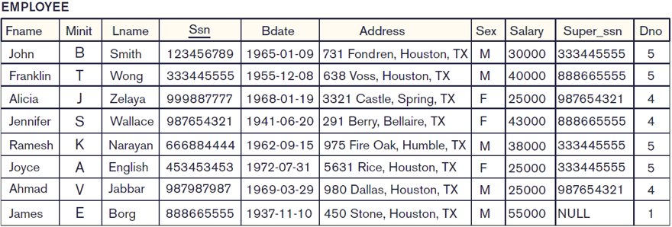
Self-Join
Retrieve the names of employees (i.e., first name and last name) and their supervisor names.
SELECT E.Fname, E.Lname, S.Fname, S.Lname
FROM EMPLOYEE E, EMPOLYEE S
WHERE E.Super_ssn = S.Ssn;
E
S

Slide 13
Non-equi join
Retrieve the first names of employees whose salary is less than others.
SELECT E1.Fname
FROM employee E1, employee E2
WHERE E1.salary < E2.salary;
E1
E2

Slide 14
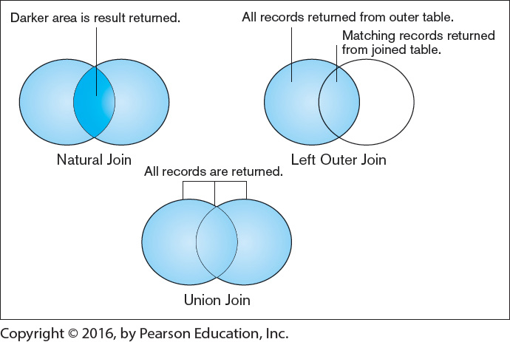
Outer Join
Outer join: A join in which rows that do not have matching values in common columns are nevertheless included in the result table. Outer joins return all the values in one of the tables included in the join, regardless of whether a match exists in the other table(s) or not.
Outer joins are often used in database maintenance to find rows that do not have matching values in common columns. Null values appear in columns where there is no match between tables.

Slide 15
LEFT Outer Join
SELECT *
FROM Students S LEFT OUTER JOIN Rooms R ON S.rid = R.rid;
Students
Rooms
sid | sname | rid
S01 | Emma | NULL
S02 | Smith | R02
S03 | Ava | R03
S04 | Lucas | NULL
rid | rname
R01 | Owl
R02 | Hawk
R03 | Tiger
R04 | Lion
sid | sname | rid | rname
S02 | Smith | R02 | Hawk
S03 | Ava | R03 | Tiger
S01 | Emma | NULL | NULL
S04 | Lucas | NULL | NULL

Slide 16
RIGHT Outer Join
SELECT *
FROM Students S RIGHT OUTER JOIN Rooms R ON S.rid = R.rid;
Students
Rooms
sid | sname | rid
S01 | Emma | NULL
S02 | Smith | R02
S03 | Ava | R03
S04 | Lucas | NULL
rid | rname
R01 | Owl
R02 | Hawk
R03 | Tiger
R04 | Lion
sid | sname | rid | rname
S02 | Smith | R02 | Hawk
S03 | Ava | R03 | Tiger
NULL | NULL | R01 | Owl
NULL | NULL | R04 | Lion

Slide 17
FULL Outer Join
SELECT *
FROM Students S FULL OUTER JOIN Rooms R ON S.rid = R.rid;
Students
Rooms
sid | sname | rid
S01 | Emma | NULL
S02 | Smith | R02
S03 | Ava | R03
S04 | Lucas | NULL
rid | rname
R01 | Owl
R02 | Hawk
R03 | Tiger
R04 | Lion
sid | sname | rid | rname
S02 | Smith | R02 | Hawk
S03 | Ava | R03 | Tiger
S01 | Emma | NULL | NULL
S04 | Lucas | NULL | NULL
NULL | NULL | R01 | Owl
NULL | NULL | R04 | Lion

Slide 18
NULL
Null represents a value for an attribute that is currently unknown or is not applicable for this tuple.
Unknown value. A person’s date of birth is not known
Unavailable or withheld value. A person has a home phone but does not want it to be listed.
Not applicable attribute. An attribute CollegeDegree would be NULL for a person who has no college degree because it does not apply to that person.

Slide 19
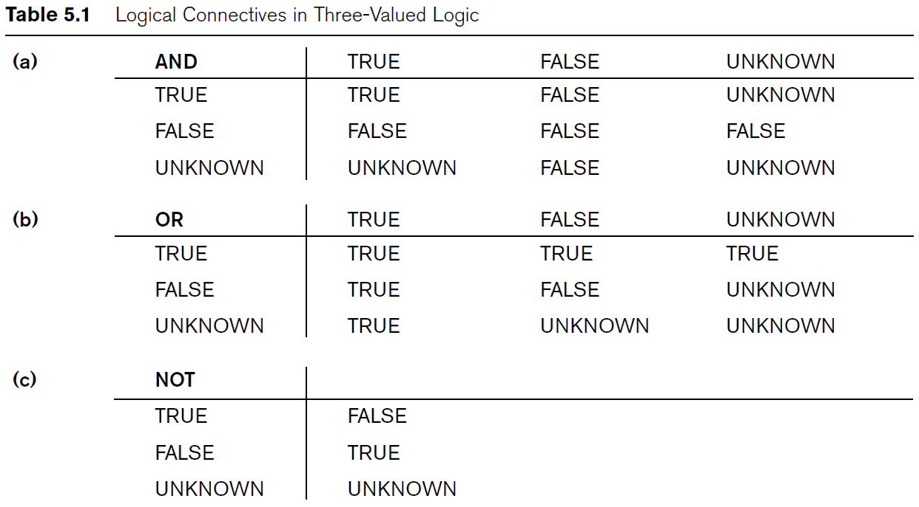
Boolean Operations

Slide 20
NULL Search Condition
IS NULL
IS NOT NULL
Retrieve the names of employees who do not have a supervisor.
SELECT E.Fname, E.Lname
FROM employee E
WHERE E.Super_ssn IS NULL;

Slide 21
Nested Query (or Subquery)
Outer Query
Inner Query
Inner Query
Inner Query
….

Slide 22
Nested Query (or Subquery)
SELECT E.id, E.first_name, E.last_name, E.position
FROM employee E
WHERE E.branch_id = ( SELECT B.branch_id FROM branch B
WHERE B.street = ‘777 Glade Road’);
Outer Query
Inner Query
(Subquery)

Slide 23
IN
The SQL IN condition allows you to easily test if an expression matches any value in a list of values.
Multi Set
VALUE
IN
1 IN { 1, 2, 3, 4, 5, 6 }
9 IN { 1, 2, 3, 4, 5, 6 }
TRUE
FALSE
(1,1) IN { (1,1), (2,2), (3,3), (4,4) }
(9,9) IN { (1,1), (2,2), (3,3), (4,4) }
TRUE
FALSE

Slide 24
IN
Outer Query
SELECT DISTINCT P1.Pnumber
FROM project P1
WHERE P1.Pnumber IN ( SELECT P2.Pnumber
FROM project P2, department D, employee E
WHERE P2.Dnum = D.Dnumber AND D.Mgr_ssn = E.Ssn
AND E.Lname = ‘Smith’)
OR P1.Pnumber IN ( SELECT W.Pno
FROM works_on W, employee E
WHERE W.Essn = E.Ssn
AND E.Lname = ‘Smith’);
Subquery (Inner Query)

Slide 25
IN
Outer Query
Subquery (Inner Query)
SELECT DISTINCT W1.Essn
FROM works_on W1
WHERE (W1.Pno, W1.Hours) IN ( SELECT W2.Pno, W2.Hours
FROM works_on W2
WHERE W2.Essn = ‘123456789’);

Slide 26
ALL / ANY
The ANY and ALL operators are used with a WHERE or HAVING clause.
The ANY operator returns true if any of the subquery values meet the condition.
The ALL operator returns true if all of the subquery values meet the condition.
SELECT E1.Lname, E1.Fname
FROM employee E1
WHERE E1.salary > ALL (SELECT E2.salary
FROM employee E2
WHERE E2.Dno = 5);
SELECT E1.id, E1.name, E1.salary
FROM employee E1
WHERE E1.salary > ANY (SELECT E2.salary
FROM employee E2
WHERE E2.Dno = 5);

Slide 27
Correlated Nested Query
A correlated subquery is a subquery that uses fields from the outer query (the next level above the subquery) to define the subquery.
Correlated subqueries use the result of the outer query to determine the processing of the inner query. Thus, the inner query may be somewhat different for each row referenced in the outer query.
It is generally slower than non-correlated subqueries because they must be calculated for each unique combination of fields and have a dependency on the outer query.

Slide 28
Correlated Nested Query
Retrieve the names of employees who has a dependent with the same first name and has the same sex as the employee.
SELECT E.Fname, E.Lname
FROM employee E
WHERE E.Ssn IN (SELECT D.Essn
FROM dependent D WHERE E.Fname = D.dependent_name
AND E.Sex = D.Sex);
Single Block Query (Better !)
SELECT E.Fname, E.Lname
FROM employee E, dependent D WHERE E.Ssn = D.Essn
AND E.Fname = D.dependent_name AND E.Sex = D.Sex);

Slide 29
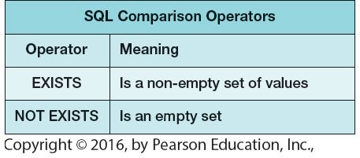
EXISTS
The EXISTS operator is used to test for the existence of any record in a subquery.

Slide 30
EXISTS
EXISTS checks whether the result of the query exists.
Retrieve the names of employees who has a dependent with the same first name and is the same sex as the employee.
SELECT E.Fname, E.Lname
FROM employee E
WHERE EXISTS (SELECT *
FROM dependent D WHERE E.Ssn = D.Essn AND E.Fname = D.dependent_name
AND E.Sex = D.Sex);
Not good !
SELECT E.Fname, E.Lname
FROM EMPLOYEE E, DEPENDENT D
WHERE E.Ssn = D.Essn AND E.Fname = D.Dependent_name AND E.Sex = D.Sex;
Better !

Slide 31
EXISTS
Retrieve the names of employees who have no dependents.
SELECT E.Fname, E.Lname
FROM EMPLOYEE E
WHERE NOT EXISTS ( SELECT D.Essn
FROM DEPENDENT D
WHERE E.Ssn = D.Essn );
SELECT E.Fname, E.Lname
FROM EMPLOYEE E LEFT OUTER JOIN DEPENDENT D
ON E.Ssn = D.Essn
WHERE D.Essn IS NULL;
Better !

Slide 32
EXISTS
List the names of managers who have at least one dependent.
SELECT E.Fname, E.Lname
FROM EMPLOYEE E
WHERE EXISTS ( SELECT * FROM DEPENDENT D WHERE E.Ssn = D.Mgr_ssn ) AND EXISTS ( SELECT * FROM DEPENDENT D WHERE E.Ssn = D.Essn );

Slide 33
EXISTS (Division)
Retrieve the names of employees who works on all the projects controlled by department number 5.
SELECT E.Fname, E.Lname
FROM employee E
WHERE NOT EXISTS ( ( SELECT P.Pnumber
FROM PROJECT P
WHERE P.Dnum = 5 )
MINUS
( SELECT W.Pno
FROM WORKS_ON W
WHERE E.Ssn = W.Essn ) );

Slide 34
DISTINCT
The SELECT DISTINCT statement is used to return only distinct (different) values.
Retrieve SSNs of employees who work on project number 1, 2, or 3.
SELECT DISTINCT W.Essn
FROM WORKS_ON W
WHERE W.Pno IN (1,2,3);

Slide 35
Aggregate Functions
Functions | Description
COUNT | returns the number of values in a specified column.
SUM | returns the sum of the values in a specified column
AVG | returns the average of the values in a specified column.
MIN | returns the smallest value in a specified column.
MAX | returns the largest value in a specified column.
SELECT min(salary), max(salary)
FROM employee;
SELECT avg(salary), sum(salary) / count(salary)
FROM employee;

Slide 36
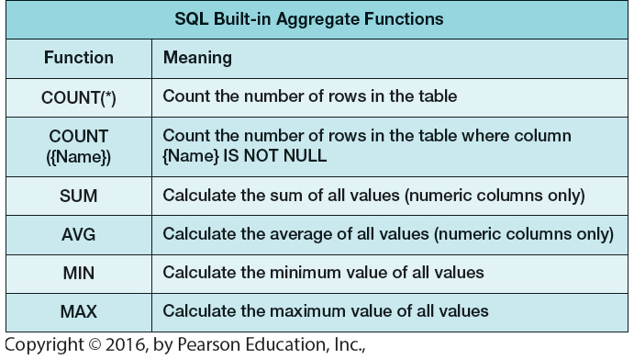
Aggregate Functions

Slide 37
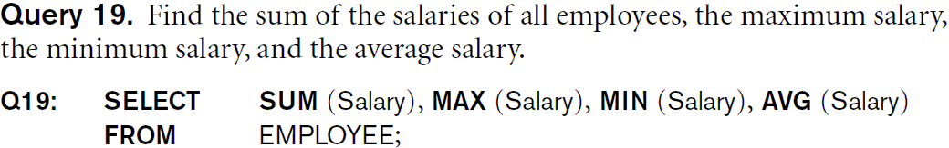
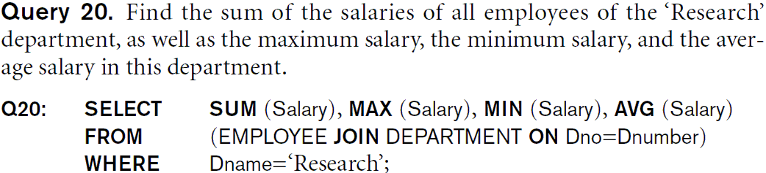
Aggregate Functions

Slide 38
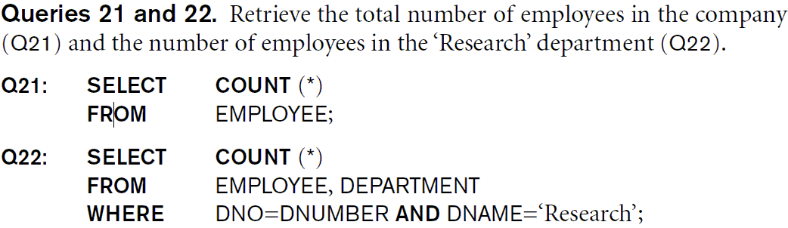
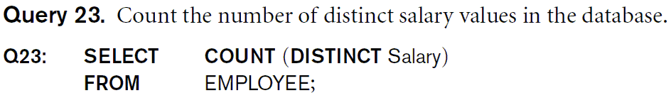
Aggregate Functions

Slide 39
Aggregate Functions
Retrieve the names of employees who have two or more dependents.
SELECT E.Fname, E.Lname
FROM employee E
WHERE 2 <= ( SELECT COUNT (*)
FROM dependent D WHERE E.Ssn = D.Essn );
SELECT E.Fname, E.Lname
FROM employee E, dependent D1, dependent D2
WHERE E.Ssn = D1.Essn
AND D1.Essn = D2.Essn
AND D1.Dependent_name <> D2.Dependent_name;

Slide 40
Aggregate Functions
Retrieve the names of employees whose salary is less than the average salary of the ‘Research’ department.
SELECT E1.name
FROM employee E1
WHERE E1.salary < ( SELECT AVG (E2.salary)
FROM employee E2, Department D
WHERE E2.Dno = D.Dnumber AND D.Dname = ‘Research’ );

Slide 41
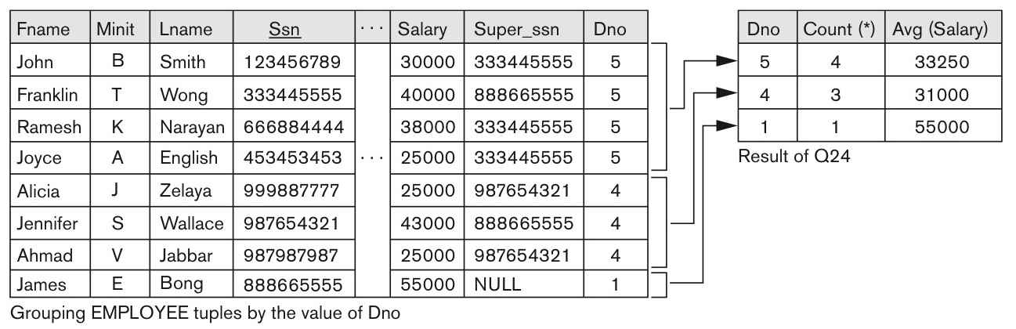
Use of Group By
For each department, retrieve the department number, the number of employees, and their average salary.
SELECT E.Dno, COUNT(*), AVG(E.Salary)
FROM employee E
GROUP BY E.Dno;

Slide 42
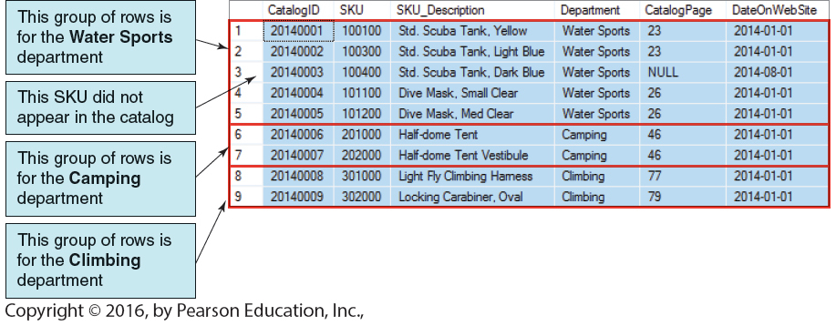
Use of Group By
Group by Department
When GROUP BY is used, each item in the SELECT list must be single-valued per group. That is, all column names in the SELECT list must appear in the GROUP BY clause unless the name is used only in an aggregate function.

Slide 43
Group By
For each project, retrieve the project number, the project name, and the number of employees.
SELECT P.Pnumber, P.Pname, COUNT(*)
FROM project P, works_on W
WHERE P.Pnumber = W.Pno
GROUP BY P.Pnumber, P.Pname;

Slide 44
Group By
For each project, retrieve the project number, the project name, and the number of employees who work on department 5.
SELECT P.Pnumber, P.Pname, COUNT(*)
FROM project P, works_on W, employee E
WHERE P.Pnumber = W.Pno
AND W.Essn = E.Ssn
AND E.Dno = 5
GROUP BY P.Pnumber, P.Pname;

Slide 45
NULL Value in the aggregation
SELECT SUM (Sales), AVG (Sales), MAX (Sales), MIN (Sales), COUNT (Sales) FROM Sales_Data;
Store | Sales
A | 300
B | 200
C | 100
D | NULL
SUM (Sales) | AVG (Sales) | MAX (Sales) | MIN (Sales) | COUNT (Sales)
600 | 200 | 300 | 100 | 3
Handling of nulls in aggregate functions: each function eliminates nulls first and operates only on the remaining non-null values.

Slide 46
Group By (Oracle)
SELECT to_char (O.date, 'MM'), count(*)
FROM order O
GROUP BY to_char (O.date, 'MM')
ORDER BY 1;

Slide 47
Having clause (Restricting groups)
The HAVING clause is designed for use with the GROUP BY clause to restrict the group.
The HAVING clause is like WHERE but operates on grouped records returned by a GROUP BY.
For each project where more than two employees are working, retrieve the project number, the project name, and the number of employees.
SELECT P.Pnumber, P.Pname, COUNT(*)
FROM project P, works_on W
WHERE P.Pnumber = W.Pno
GROUP BY P.Pnumber, P.Pname
HAVING COUNT (*) > 2;

Slide 48
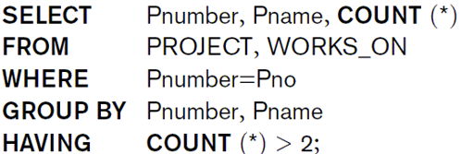
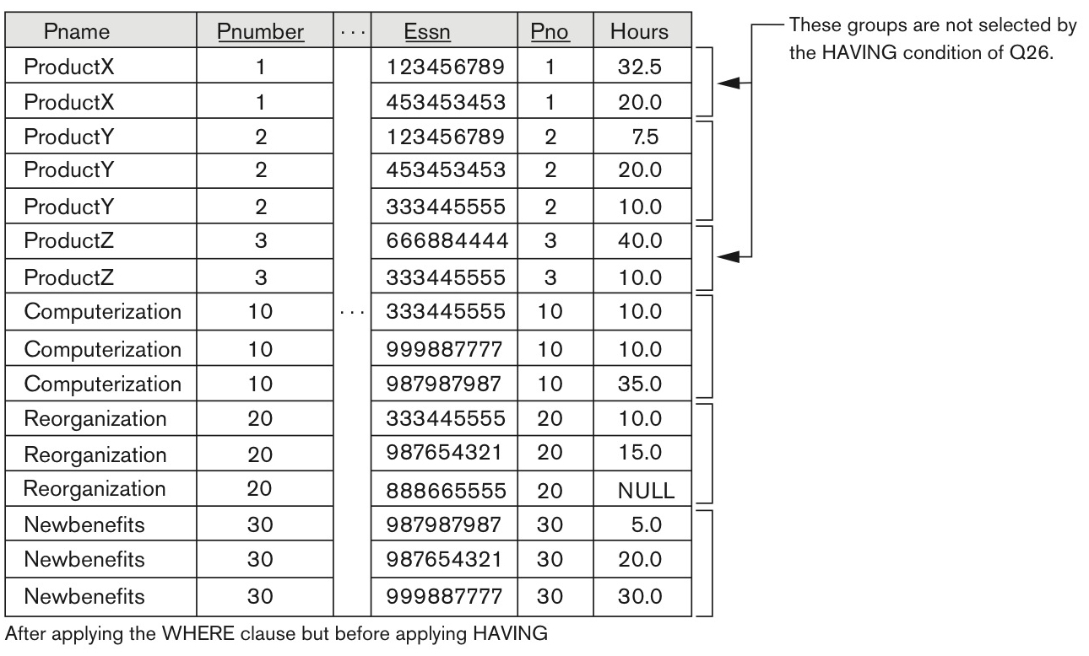
Group By, Having

Slide 49
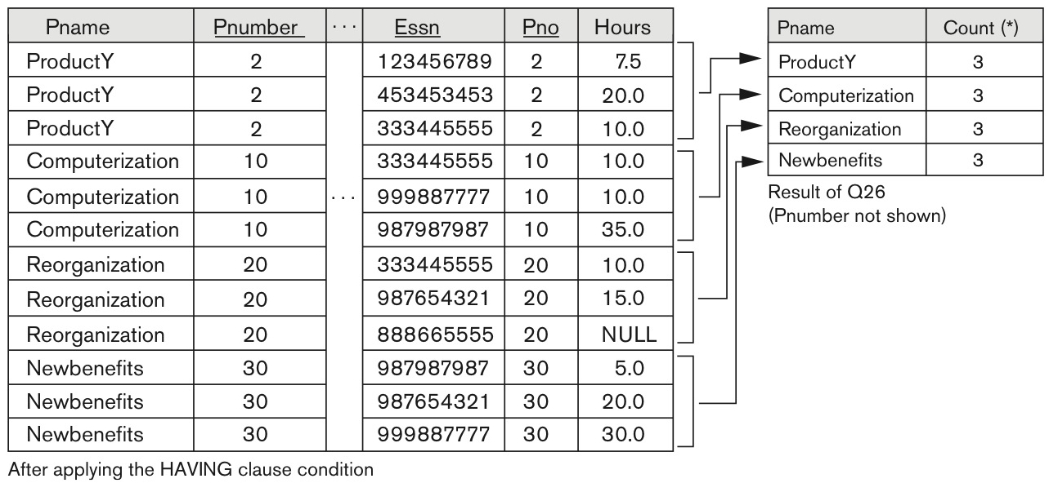
Group By, Having
SELECT P.Pname, COUNT(*)
FROM project P, works_on W
WHERE P.Pnumber = W.Pno
GROUP BY P.Pnumber, P.Pname
HAVING COUNT (*) > 2;

Slide 50
Having
For each project where more than five employees are working, retrieve the department and the number of employees who are making more than $40,000.
SELECT E.Dno, COUNT(*)
FROM department D, employee E
WHERE D.Dnumber = E.Dno
AND E.salary > 40,000
AND E.Dno IN ( SELECT E2.dno
FROM Employee E2
GROUP E2.Dno
HAVING COUNT (*) > 5 );

Slide 51
Having
SELECT dep_id, min(salary), avg(salary), max(salary), count(*)
FROM Employees
GROUP BY dept_id
HAVING COUNT(*) > 1
AND min(salary) BETWEEN 2500 AND 17000
AND avg(salary) <> 5000
AND max(salary) / min(salary) < 2;

Slide 52
Having
SELECT E1.dept_id, AVG(E1.salary)
FROM employees E1
GROUP BY E1.dept_id
HAVING AVG (E1.salary) > ( SELECT AVG (E2.salary)
FROM employees E2
WHERE E2.dept_id = 5);

Slide 53
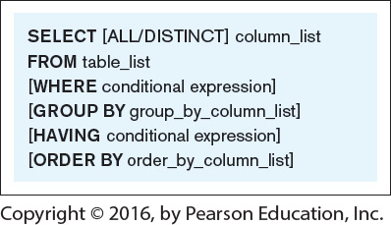
Review
FROM Specifies the table or tables to be used.
WHERE Filters the rows subject to some condition.
GROUP BY Forms groups of rows with the same column value.
HAVING Filters the groups subject to some condition.
SELECT Specifies which columns are to appear in the output.
ORDER BY Specifies the order of the output.

Slide 54
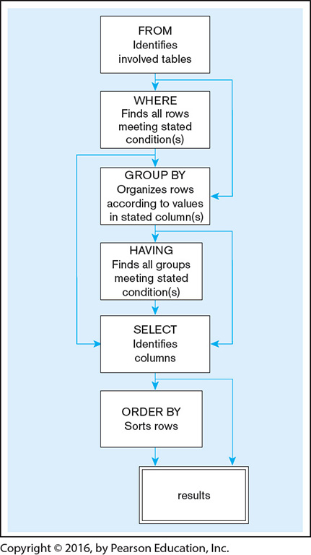
Review
FROM
WHERE
GROUP BY
HAVING
SELECT
ORDER BY

Slide 55
Views
The dynamic result of one or more relational operations operating on the base relations to produce another relation.
A view is a virtual relation that does not necessarily exist in the database but can be produced upon request by a particular user, at the time of request.

Slide 56
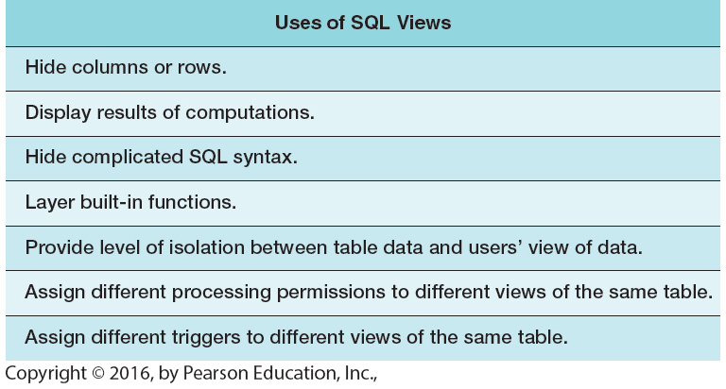
Views

Slide 57
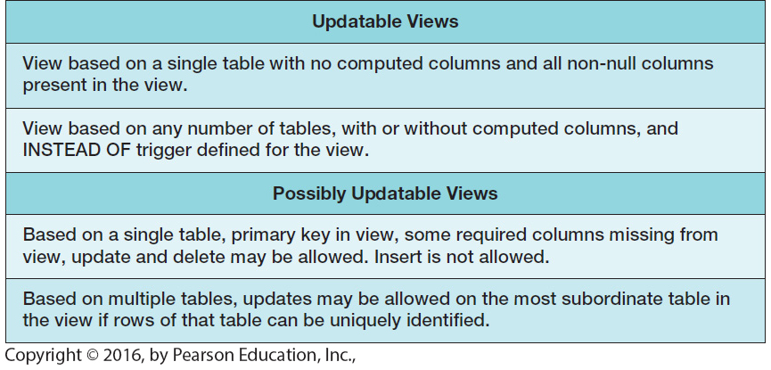
Views

Slide 58
Views
A view is created from a query using the CREATE VIEW command.
CREATE VIEW fau_student_view AS SELECT *
FROM student S
WHERE S.school= ‘FAU’;
Once a view is created you can use them as you would any table in a SELECT statement.
SELECT * FROM fau_student_view;
DROP VIEW fau_student_view;

Slide 59
Views
CREATE VIEW staff_cnt (branch_id, cnt) AS SELECT S.branch_id, COUNT(*)
FROM staff S, branch B
WHERE S.branch_id = B.id
GROUP BY S.branch_id;

Slide 60
Benefits of a Database View
Views can simplify SELECT statements.
Views can increase reusability.
View can enforce security restrictions.

Slide 61
WITH
SQL:1999 added the with clause to define “statement scoped views”. They are not stored in the database schema: instead, they are only valid in the query they belong to.
WITH big_depts(dno) AS ( SELECT dno
FROM employee
GROUP BY dno
HAVING count(*) >5 )
SELECT E.dno, COUNT(*)
FROM employee E
WHERE E.salary > 10000
AND E.dno IN big_depts
GROUP BY E.dno;

Slide 62
CASE
The CASE statement goes through conditions and returns a value when the first condition is met.
SQL:99
UPDATE employee
SET salary =
CASE WHEN dno=1 THEN salary + 1000
WHEN dno=2 THEN salary + 2000
WHEN dno=3 THEN salary + 3000
ELSE salary + 0;

Slide 63
WITH RECURSIVE
Retrieve all supervisees of a supervisory employee at all levels.
SQL:99
WITH RECURSIVE sup_emp (sup_ssn, ssn) AS (
SELECT sup_ssn, ssn
FROM employee
UNION
SELECT E.ssn, S.sup_ssn
FROM employee as E, sup_emp S
WHERE E.sup_ssn = S.ssn )
SELECT *
FROM sup_emp;

Slide 64
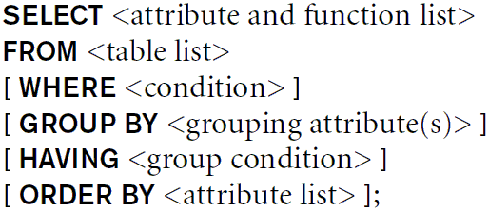
Retrieval Operations

Slide 65
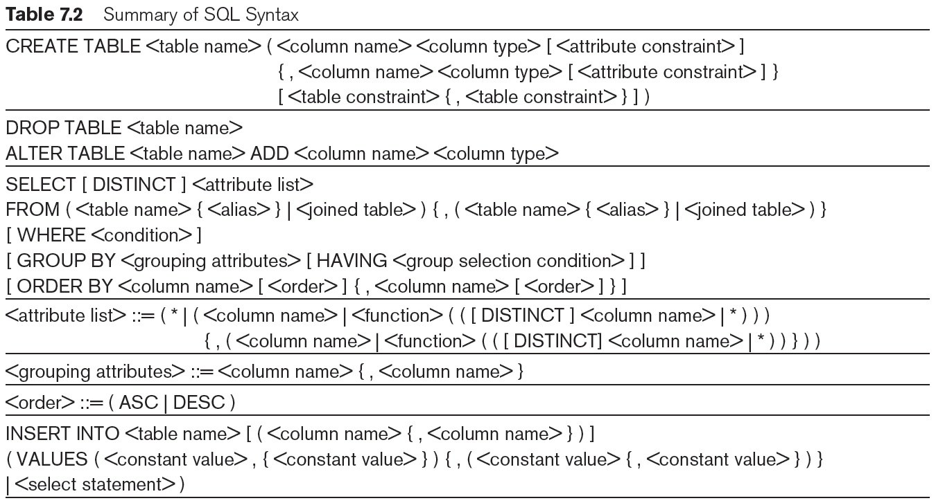
Take home message

